Slide 1
A Convex Two-Dimensional Variable Selection Method for the Root-Cause Diagnostics of Product Defects
Chengyu Zhou
Joint work with Dr. Xiaolei Fang
Edward P. Fitts Department of Industrial and Systems Engineering
North Carolina State University

Slide 2

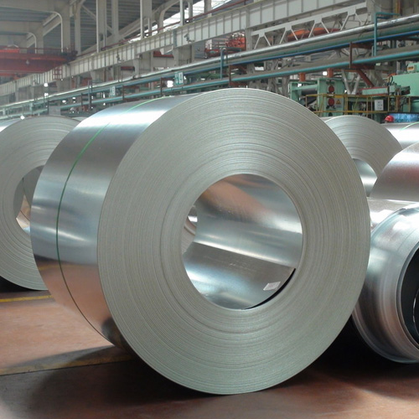
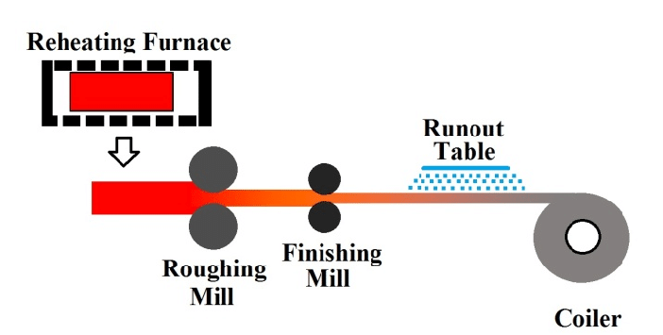
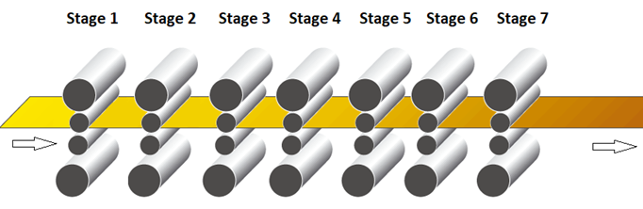

Motivation: Hot Rolling Product Defects
Coiled steel strips
Steel slab
Notes:
Hot rolling is a process in a steel plant in which the semifinished slab is reheated to a predetermined temperature and the hot slab is rolled to make the specified hot strip in a coiled form
Old production line used for many years;
Upgraded the production line in last year, buying some new machines and updated the control algorithms to improve the producing efficiency.
After the upgrading, they started to have some quality defects.

Slide 3
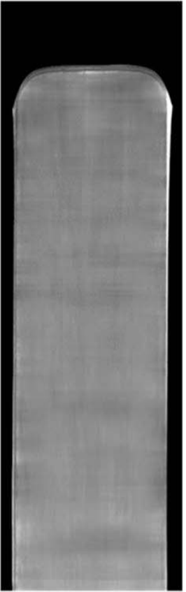
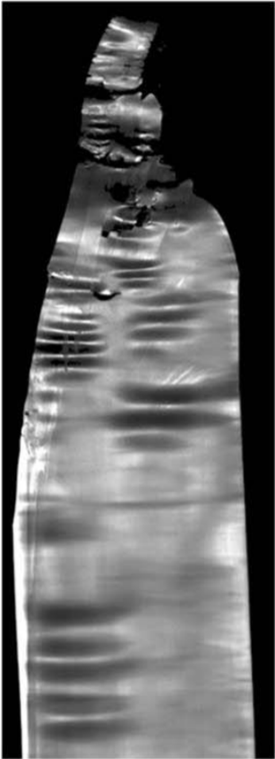
Quality Defects and Objectives
No Defect
(Good quality)
Defect
(Bad quality)
Objectives: Find out the root-cause of the product defects, i.e., diagnostics ➔ Identify the crucial variables and/or stages that result in quality defects
Notes:
Before upgrading, they have no defect;
After upgrading, they have the defect from time to time
#####They wanted to find out why the defect happens? However, it is very challenging to find out the reason from the control model they use because the control model is very complicated and involves knowledge in material science, control theory, etc.
In this topic, we are trying to develop some data analytics methods to help them identify the reason of the defects.
This is pretty challenging since the rolling process involves many control variables

Slide 4
Control/Sensor Variables
Stage 1 | Stage 2 | Stage 3 | … | Stage 7
Target Speed
Real Speed
Looper Height
… Target Force
Roller Gap
OR
X
Y

Slide 5
Naïve Solutions
Stage 1 | Stage 2 | Stage 3 | … | Stage 7
Target Speed
Real Speed
Looper Height
… Target Force
Roller Gap
Y=1
OR
Y=0
…
Target Speed
Real Speed
X
Y
Naïve Solution: Logistic Regression + LASSO

Slide 6
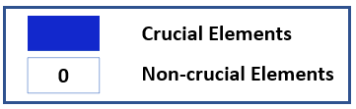
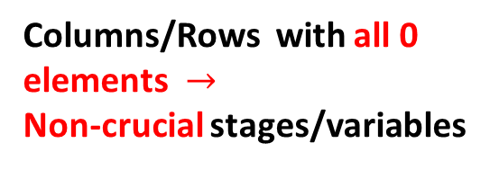
Naïve Solutions and Challenges
Stage 1 | Stage 2 | Stage 3 | … | Stage 7
Target Speed
Real Speed
Looper Height
… Target Force
Roller Gap
 | 0 | 0 | 0
0 |  |  | 0 | 0
0 | 0 | 0 |  | 0
 | 0 | 0 | 0
0 | 0 |  | 0 | 0
0 |  | 0 | 0
Unstructured Selection Results
(Cannot identify the crucial stages and variables simultaneously)
Stage 1 | Stage 2 | Stage 3 | … | Stage 7
Columns/Rows with all 0 elements $→$
Non-crucial stages/variables
Target Speed
Real Speed
Looper Height
… Target Force
Roller Gap
 | 0 |  | 0 | 0
0 | 0 | 0 | 0 | 0
 | 0 |  | 0 | 0
0 | 0 | 0 | 0 | 0
0 | 0 | 0 | 0 | 0
 | 0 |  | 0 | 0
Structured Selection Results
(Can identify the crucial stages and variables simultaneously)

Slide 7
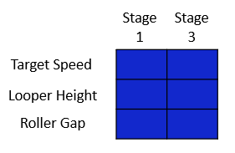
Two Questions Asked by Engineers
Two Questions
Which process variable(s) and stage(s) are responsible for product defects ? Group-wise selection
In each stage considered to be overall important, which process variable(s) are related to product defects? Element-wise selection
Stage 1 | Stage 2 | Stage 3 | … | Stage 7
Target Speed
Real Speed
Looper Height
… Target Force
Roller Gap
 | 0 |  | 0 | 0
0 | 0 | 0 | 0 | 0
 | 0 |  | 0 | 0
0 | 0 | 0 | 0 | 0
0 | 0 | 0 | 0 | 0
 | 0 |  | 0 | 0
Proposed Solution: Generalized Linear Model + Penalized Matrix Regression

Slide 8
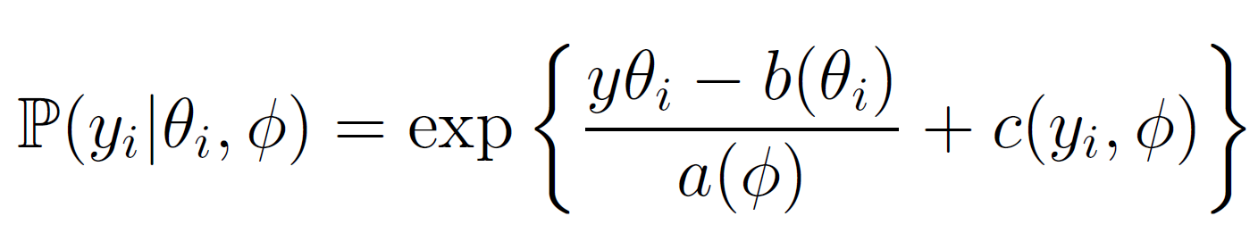
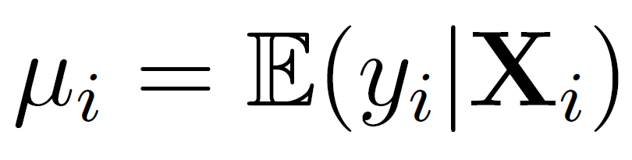
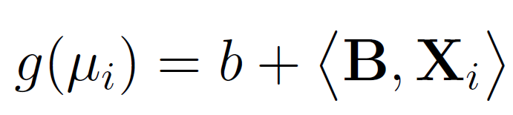
2D Variable Selection: Proposed Method
Generalized Linear Model (GLM)
Product Quality
Intercept
?

Slide 9

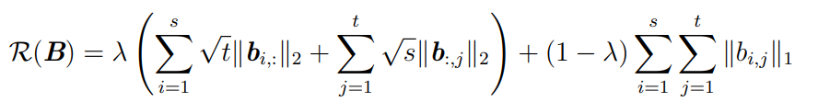

2D Variable Selection: Proposed Method
Penalty Term
Negative Log-
likelihood Function
Tuning Parameter
0 |  |  | 0
 |  | 0
0
 |  | 0
0 | 0 | 0 | 0
0 | 0 | 0 | 0
 | 0 | 0
 | 0 | 0
 | 0 | 0
 | 0 | 0

Slide 10
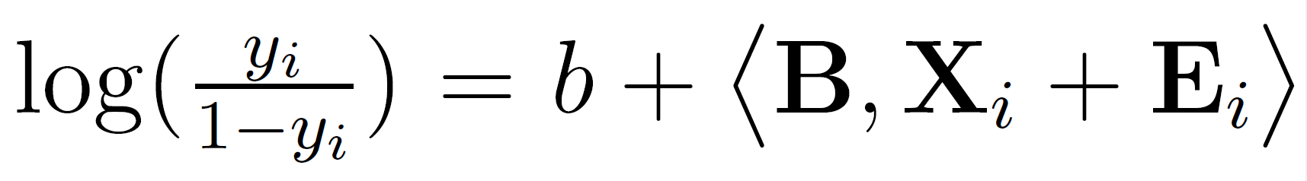
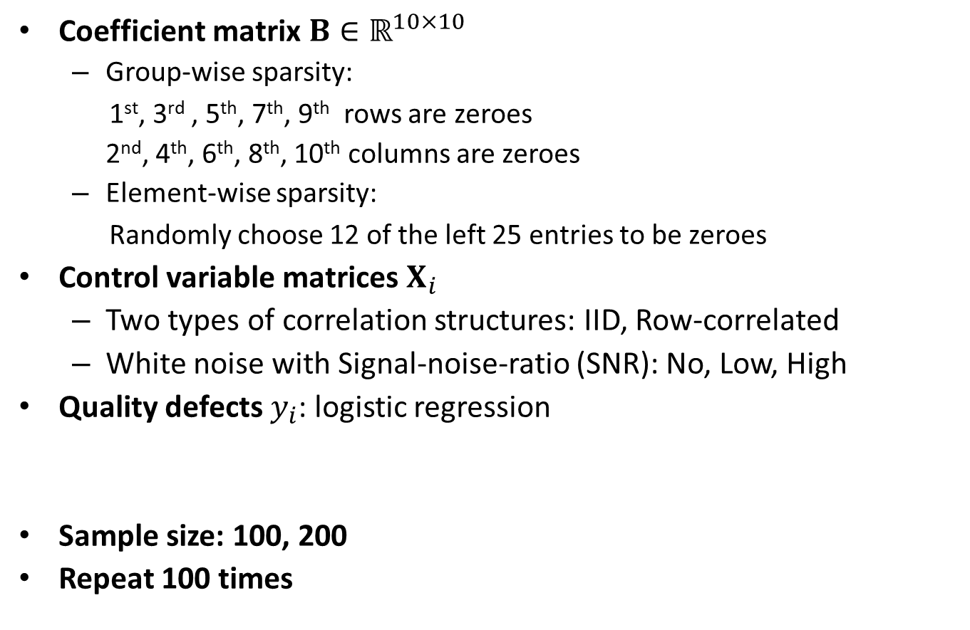
Simulation Study
Coefficient matrix $B∈ℝ^{10×10}$
Group-wise sparsity:
1st, 3rd , 5th, 7th, 9th rows are zeroes
2nd, 4th, 6th, 8th, 10th columns are zeroes
Element-wise sparsity:
Randomly choose 12 of the left 25 entries to be zeroes
Control variable matrices $X_{i}$
Two types of correlation structures: IID, Row-correlated
White noise with Signal-noise-ratio (SNR): No, Low, High
Quality defects $y_{i}$: logistic regression
Sample size: 100, 200
Repeat 100 times

Slide 11


Simulation Study
Benchmarks: (Jeong, C. and Fang, X, 2021)
Selection accuracy

Slide 12
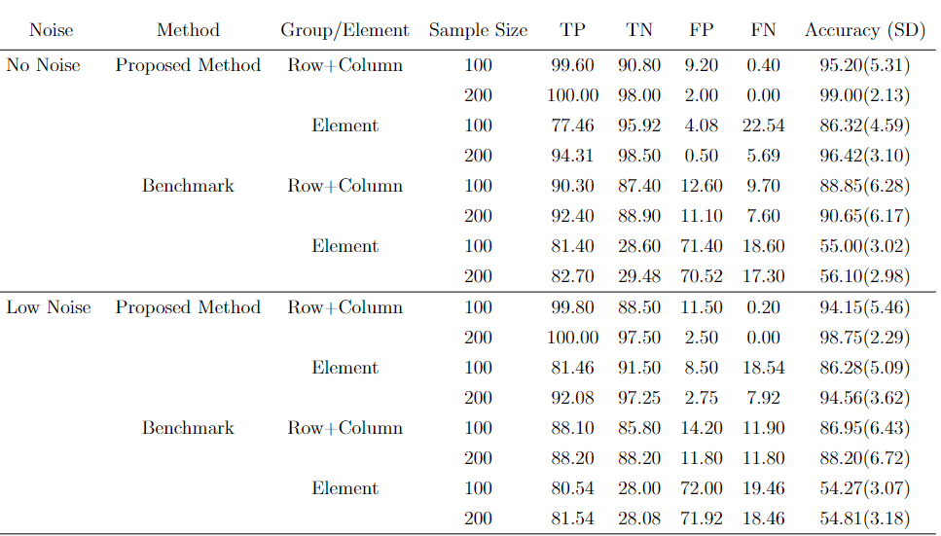
Results: IID
Under all sample sizes and noise levels, the proposed method outperforms the benchmark in both group-wise selection and element-wise selection.
For the proposed method and benchmark, the performance improves with the increase of sample size and the decrease of noise.

Slide 13
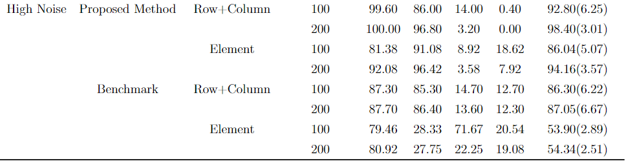
Results: IID
Under all sample size and noise levels, the proposed method outperforms the benchmark in both group-wise selection and element-wise selection.
For the proposed method and benchmark, the performance improves with the increase of sample size and the decrease of noise.

Slide 14
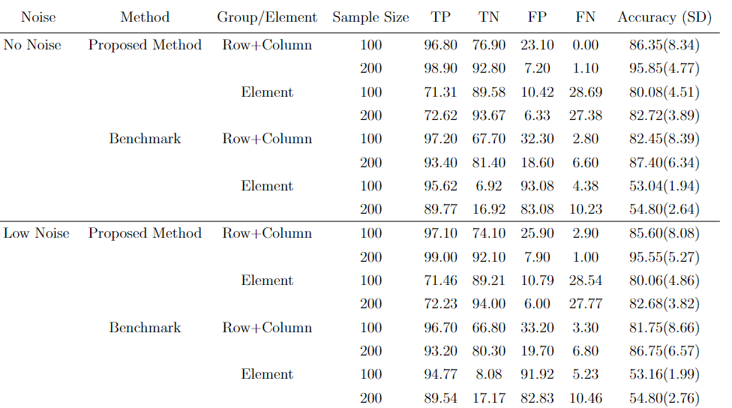
Results: Row-Correlated
All the conclusions drawn from IID scenario holds in the row-correlated scenario.
The proposed method and benchmark have a worse performance in row-correlated scenario compared with IID scenario.

Slide 15
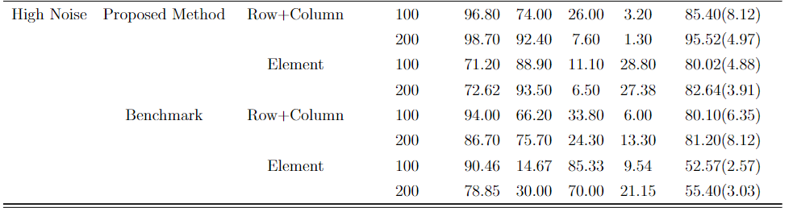
Results: Row-Correlated
All the conclusions drawn from IID scenario holds in the row-correlated scenario.
The proposed method and benchmark have a worse performance in row-correlated scenario compared with IID scenario.

Slide 16
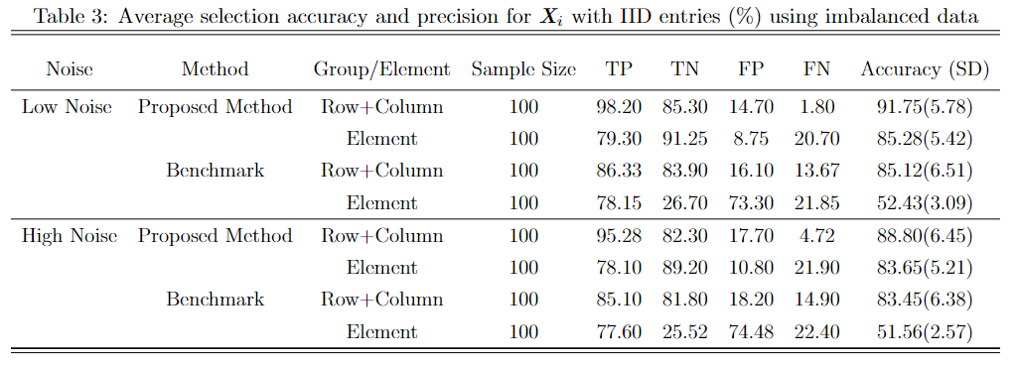

Results: Imbalanced Data
100 samples: 90 good quality ($y_{i}$> 0.5) and 10 bad quality ($y_{i}$ < 0.5)
Control variable matrices $X_{i}$ is IID
All the conclusions drawn earlier still holds.
Data imbalance comprises the performance of the proposed method and benchmark.

Slide 17
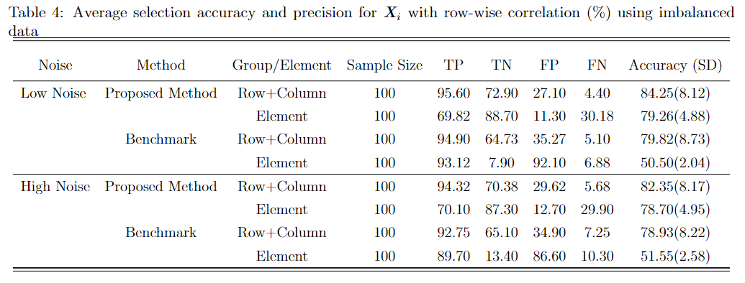

Results: Imbalanced Data
Control variable matrices $X_{i}$ is Row-Correlated
All the conclusions drawn earlier still holds.
Data imbalance comprises the performance of the proposed method and benchmark.

Slide 18
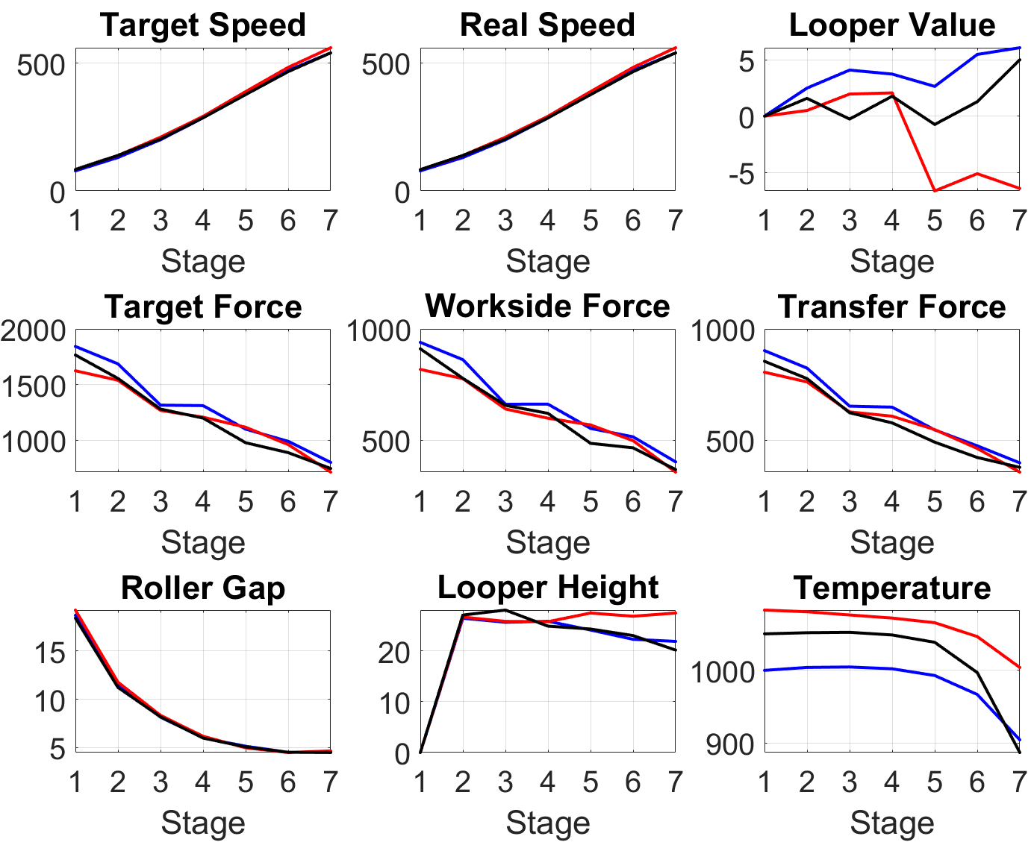
Cast Study
490 steel strips: 264 good quality, 226 bad quality
9 variables, 7 stages
Randomly select 400 samples for training; repeat 100 times; any row/column/element whose selection rate > 0.5 is considered crucial.

Slide 19
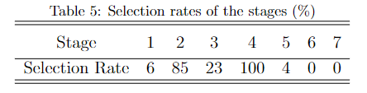
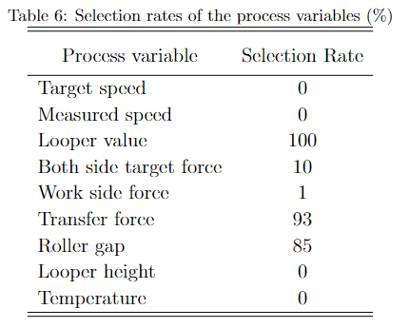
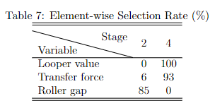
Case Study: Results
Crucial process variables: Looper value, roller gap, and transfer force
Crucial stages: Stage 2 and 4
Important variables in crucial stages:
Roller gap in Stage 2
Looper value and transfer force in stage 4

Slide 20
Summary and Conclusions
A novel convex two-dimensional variable selection method that can inspire both group-wise and element-wise sparsity was proposed for root cause diagnostics of product defects. It is a penalized matrix regression model which consists of a negative log-likelihood function, two L2 penalization terms and one L1 penalization term.
Simulation and real-world data were used to validate the performance. The results indicated that our methodology outperformed the benchmark in terms of both prediction accuracy and precision.

